Slide 1
iRyP: A Purely Edge-based Privacy-Respecting System for Mobile Cameras
Yuanyi Sun ¹ Shiqing Chen ¹ Sencun Zhu ¹ Yu Chen ²
¹ Penn State University
² State University of New York

Slide 2
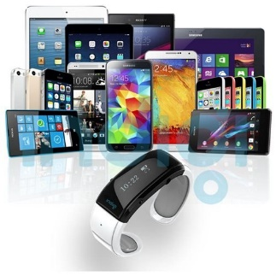
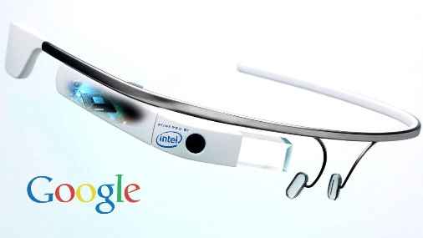
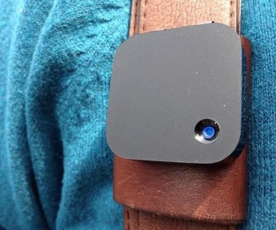





Mobile/Wearable devices growing popular
Mobile/wearable devices include smartphones, smartwatches, tablets, smart glasses, and lifelogging cameras.
More and more people have become used to recording life with mobile (or wearable) cameras, from public events to individual activities, and share them online.

Slide 3
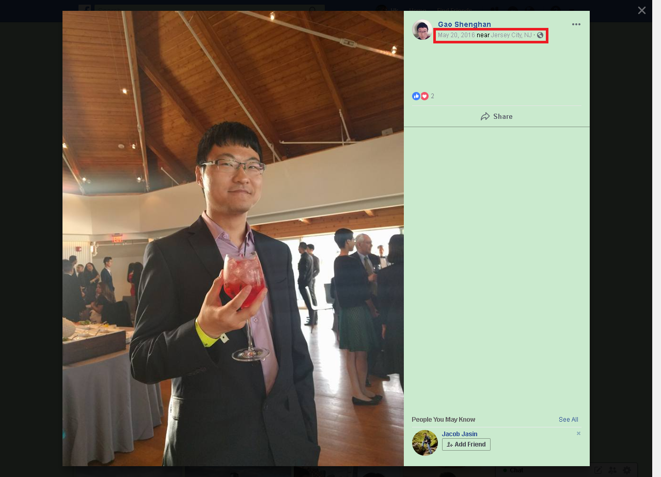

Camera Privacy Example
I do not want anyone to track me and record when and where I show up.
Notes:
adversary->attacker

Slide 4
User studies have shown
Many people do care about this privacy issue [1][2][3].
  [1] “Privacy behaviors of lifeloggers using wearable cameras,” in ACM UbiComp 2014
  [2] “In situ with bystanders of augmented reality glasses: Perspectives on recording and privacy-mediating technologies,” in ACM conference on Human factors in computing systems 2014
  [3] “I-pic: A platform for privacy-compliant image capture,” in ACM Mobisys 2016.
People want to customize their own context-dependable policies [3].
Camera users would choose to comply with the privacy preferences of friends and strangers, as long as doing so would not interfere with the spontaneity of media recording [3].

Slide 5

Design Goal and Research Questions:
How do people define their privacy policies?
How do they share the policies?
How to match an face in the view?
How to protect visual privacy?

Slide 6

How to define privacy policies?
Policy encoding:
  0 = no photography, no share
  1 = allow photography, allow share on Facebook
  2 = allow photography, allow share on Instagram
  …
  65535 = allow photography, allow share anywhere
I am Bob. My privacy policy is “photographing allowed but no sharing”. In iRyP system, this policy can be coded in two bytes for a limited number of scenarios.

Slide 7
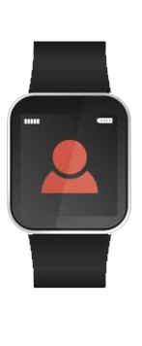


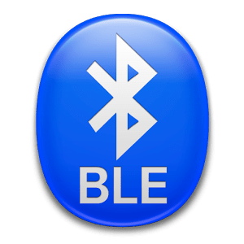
How to share policies?
BLE Broadcasting
Bob’s Smartwatch
Alice’s Phone(camera)
There are up to 24 bytes in each advertising message to piggyback one's own data without affecting the normal operation of BLE.
Notes:
Bluetooth low energy (BLE) is wireless personal short-range network technology.
We embed privacy policies into BLE advertising messages, which are periodically broadcasted.

Slide 8
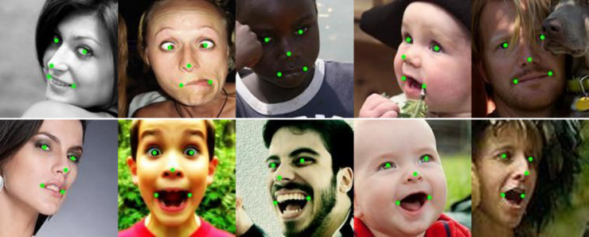
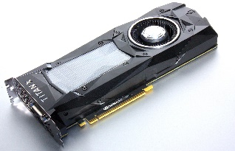

Face Detection Algorithm
Algorithm requirements: high efficiency, high accuracy, side faces detection, and landmarks detection.
DPM v5, Faster R-CNN, and YOLO require GPU.
OpenCV with haar cascades are not good at detecting side faces.

Slide 9
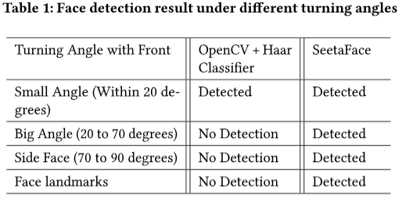
Why SeetaFace?
We use SeetaFace, which has high accuracy, high efficiency, and is good at side faces and landmarks detection.
Seetaface does not need GPU.
Seetaface detects all angles faces.

Slide 10
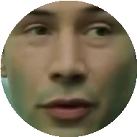
Face Perceptual Hashing
Bob needs to generate his visual signature (facial features) to be embedded in his BLE advertising messages, based on which a photographer matches it with a person in the photo .
We only have 24 bytes to store facial features, far from enough.
Our solution is pHash: Perceptual Hashing
1 1 1 1 0 0 0 0 1 1 1 1 0 0 0 0 1 1 1 1 0 0 0 0 0 1 1 1 0 0 0 0 0 1 1 0 0 0 0 1 1 1 0 0 0 0 0 0 0 0 0 0 0 0 0 0 0 0 0 0 0 0 0 0
Hamming Distance is the number of different bits between two face hashes.

Slide 11
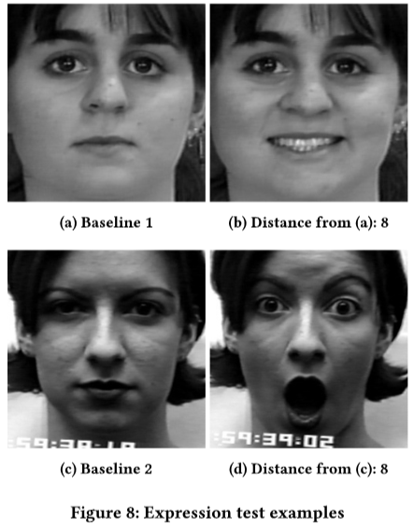
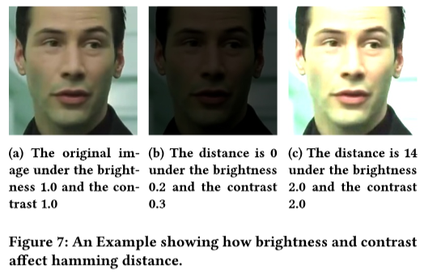
Robustness of Face Perceptual Hashing

Slide 12
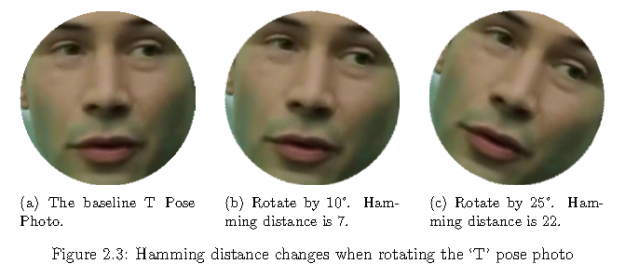
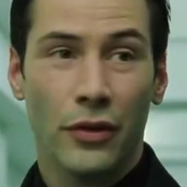
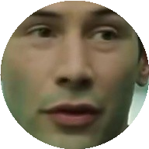
Face Normalization
Calibrating Head Rotation
Background Noise Reduction

Slide 13
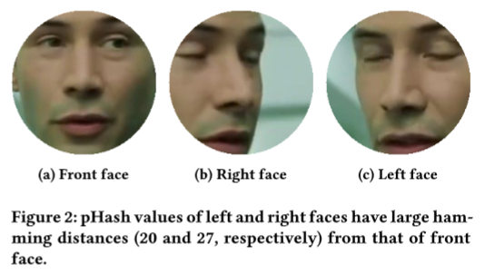
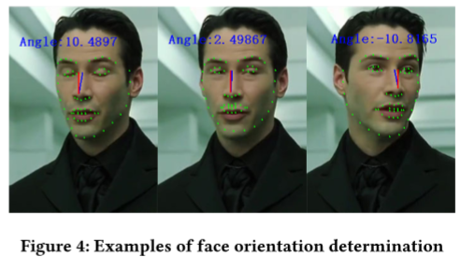
Face Matching
Three hash values instead of one hash value to represent one person.
Face orientation determination: only match with the face of the same orientation.
Notes:
Bob's face might be captured by others in different orientations. Accuracy would be very low if the face orientation of Bob in the photo is much different from that used by Bob to build his profile.

Slide 14

How to protect privacy?
Protect the face so that people cannot identify the face.
Blur
Selected in this paper
Cartoonize
Patch

Slide 15



System Architecture
Alice’s Phone
Bob’s Smartphone (or PC)
Face Detection
Take Photo
Left
Front
Right
Bob
Face Normalization
Face Detection
Face Hashing
Face Normalization
BLE Broadcasting
Face Matching
Face Hashing
Upload
Privacy Profile
Left hash:DCC302476A183E
Front hash:C69111486A4A1B2A
Right hash:853E02A14AC02E
Privacy Policy: no photography
Policy Enforcement
Bob’s Smartwatch
Setting Privacy Policy

Slide 16
Implementation
The entire system has around 8 thousand lines of code (Including C/C++ and Java).
We import into our project the Android version of SeetaFace and OpenCV 2.4.9.
For BLE operations, we use the classes and APIs provided by the Android framework, such as “mBluetoothManager” and “mBluetoothLeAdvertiser.startAdvertising()”.

Slide 17
Thresholds of Three Faces
Thresholds of three faces. We did an offline analysis with thousands of faces and figured that the threshold value of 10 or 11 is good for front faces, 8 is good for side faces. More detail can be found at the paper.
Take the front face as an example, with the above threshold, both accuracy and recall are higher than 90%.

Slide 18
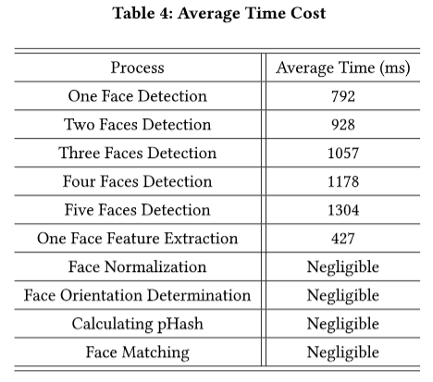
Overhead Evaluation
Each face need additional 300 ms.

Slide 19
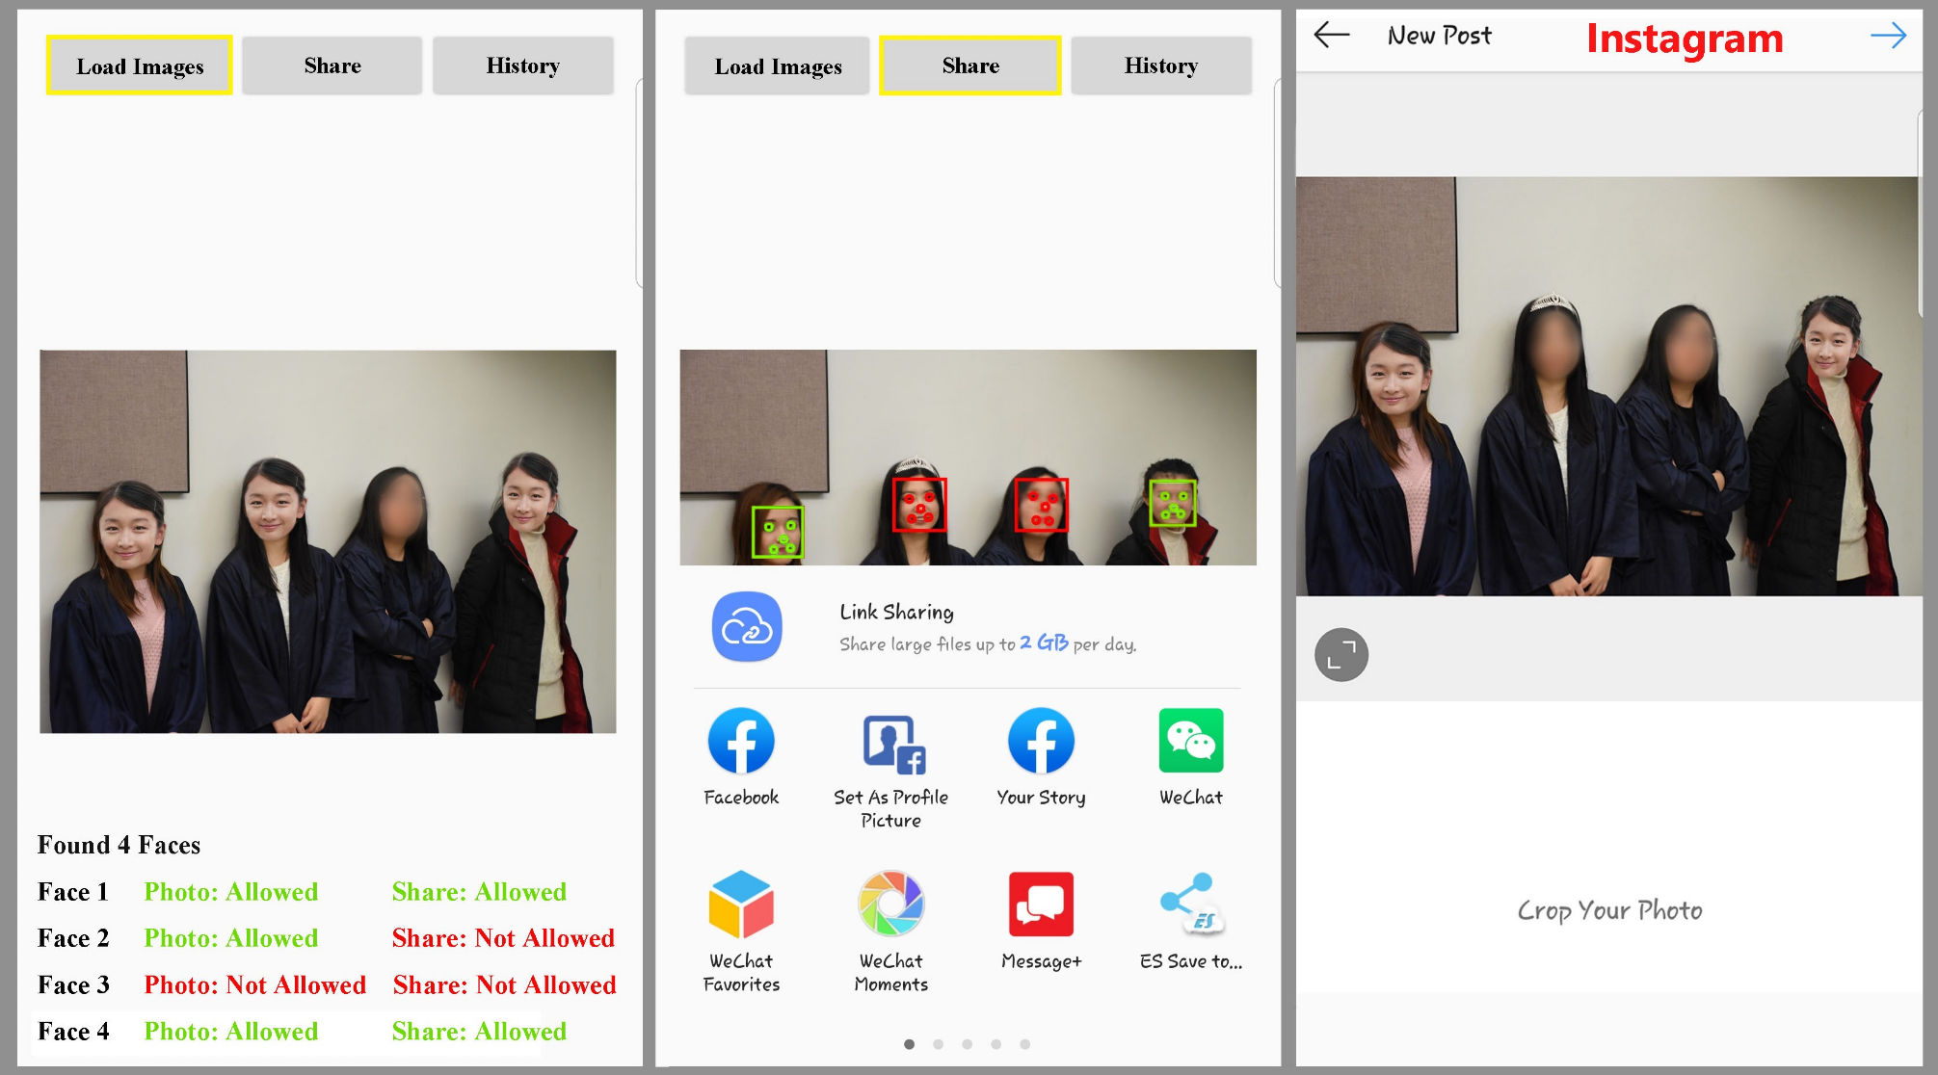
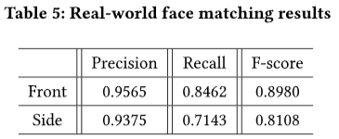
Real World Test
Test with different locations, including classroom, playground, parking lot, lobby, and hallway.

Slide 20
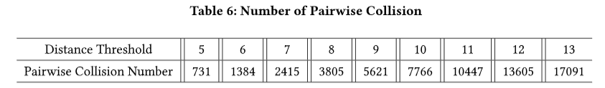
Security and Privacy Analysis
iRyP won’t compromise face-based user authentication.
  pHash is not reversible, and it is not a facial biometric.
iRyP does not enable new user tracking capibility.
  High collisions in a relatively large population. Track someone else is not feasible.

Slide 21
Existing work
I-pic: A platform for privacy-compliant image capture
  Unlike our system, the I-pic platform relies on the cloud computing platform to help match faces, and the camera needs a GPU to process images.
HideMe: Privacy-Preserving Photo Sharing on Social Networks
  Hideme is a plugin to existing photo sharing OSNs for preserving users’ privacy. Different from our work, which is a comprehensive system for mobile camera and covers both the photo-taking phase and sharing phase
Privacy. tag: Privacy concern expressed and respected
  In their system, people use QR code printed in their T-shirts to express their privacy policies. Photographer's Camera scans the QR code to learn people's privacy policies.

Slide 22
Conclusion
We presented iRyP, a purely edge-based efficient privacy-respecting system for mobile devices.
We designed several efficient and effective mechanisms to boost up the accuracy of face matching based on perceptual hashing algorithm.
We presented an Android-platform based prototype, and performed various experiments. We showed that our system has high usability and good accuracy.

Slide 23


